Slide 1

Citi Bike Data Analysis
By Clem Mordi

Slide 2
Project Goal:
To better understand the behavior of Citi Bike’s customer base (both one-time users and subscribers) and how they use Citi Bikes
This will help us to:
Identify where more bikes should be installed
Create targeted marketing campaigns that will appeal to different customer segments

Slide 3
Key questions:
What are the most popular pick-up locations across the city for Citi Bike rental?
How does the average trip duration vary across different age groups?
Which age group rents the most bikes?
How does bike rental vary across the two user groups (one-time users vs long-term subscribers) on different days of the week?
Does the factor of user age impact the average bike trip duration?

Slide 4
Findings & Insights

Slide 5
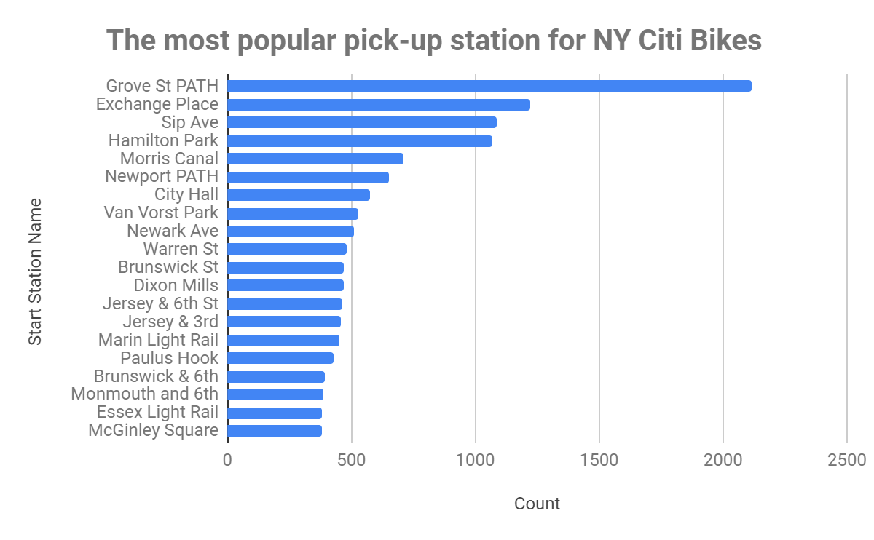
What are the most popular Citi Bike pick-up locations?

Slide 6
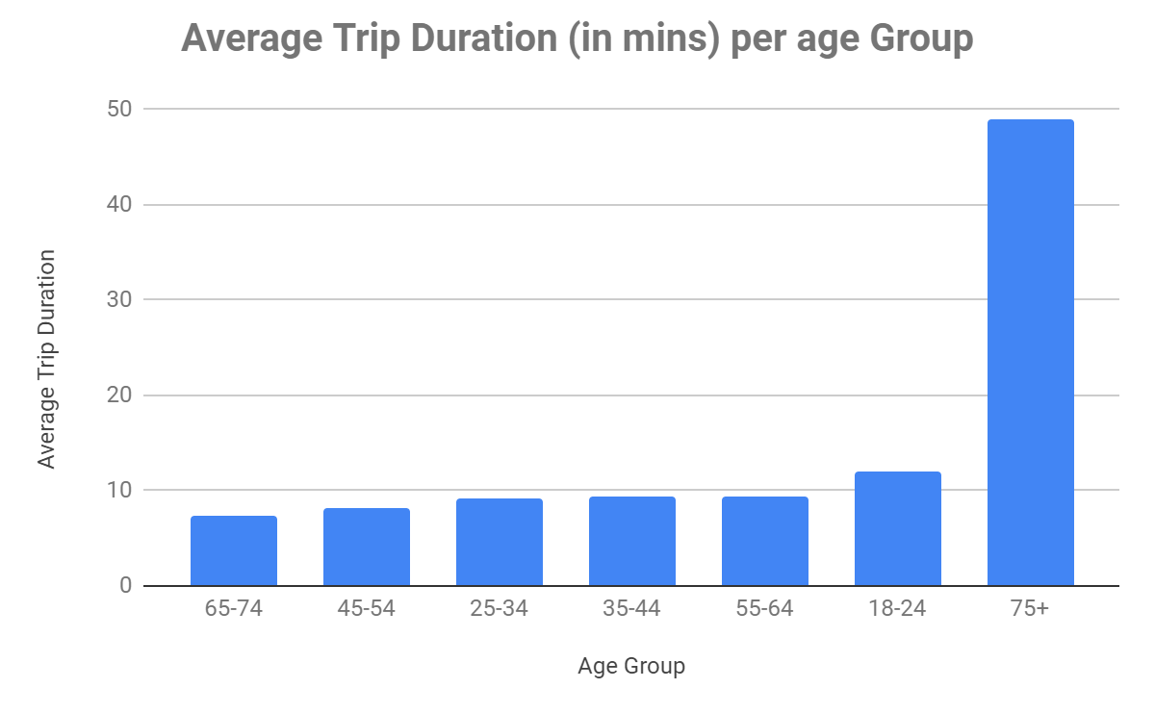
2. How does the average trip duration vary across different age groups?
65-74,and 45-54 age groups have the least average trip duration.
Meanwhile, the 75+ age group has the highest trip duration on average with a wide margin between them and the 18-24 age group that trails as the second highest on average

Slide 7
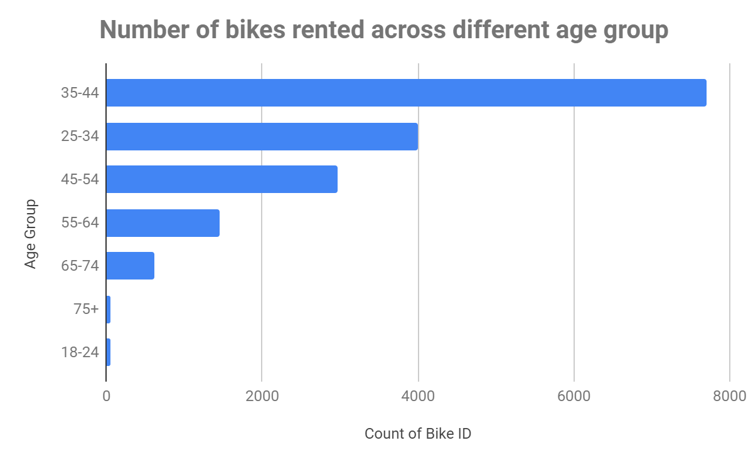
3. Which age group rents the most bikes?
While the 75+ age group seemingly engages the most trip duration on average, the viz reveals that the 35-44 age group rents the most bikes in NY Citi Bikes
Meanwhile, the 75+ and 18-24 age groups rent the least bikes

Slide 8
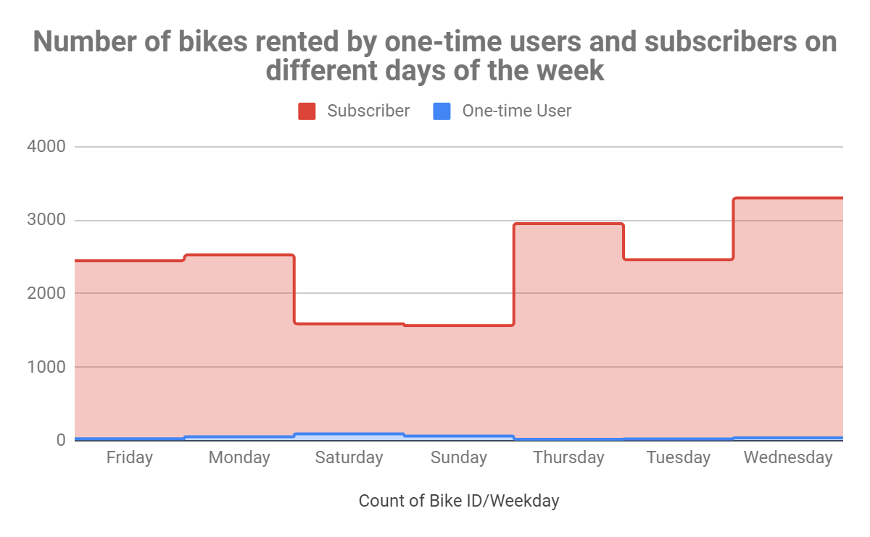
4. How does bike rental vary across the two user groups (one-time users vs long-term subscribers) on different days of the week?
One-time users are most likely to rent bikes during weekends
Long-term subscribers rent bikes every day of the week, but have reduced bike rental activities at weekends(Saturdays and Sundays).

Slide 9
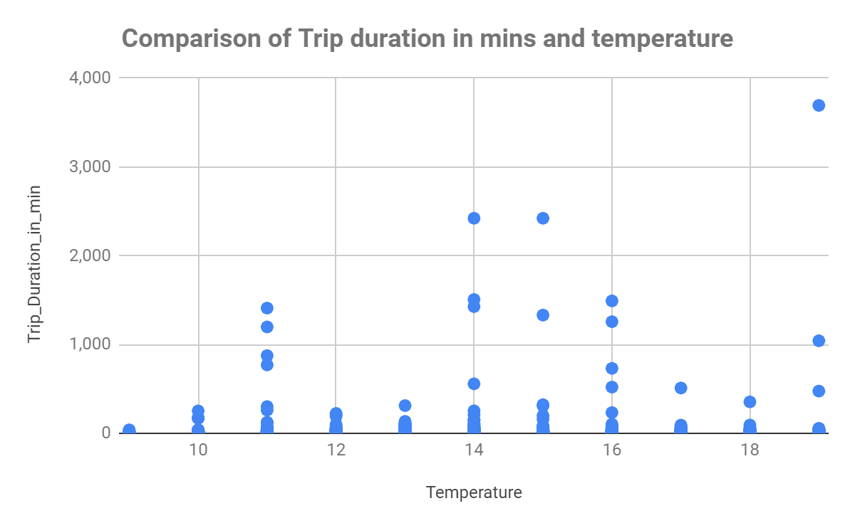
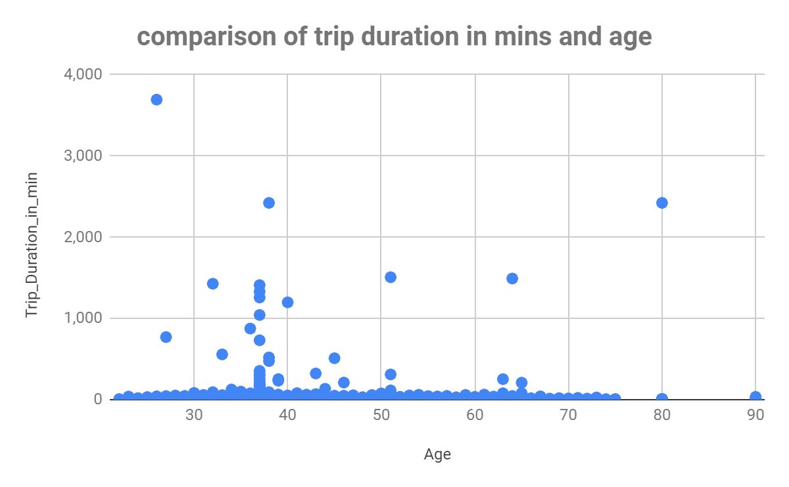
5. Do factors like weather and age impact the average bike trip duration?
There is no vivid correlation between the weather and the trip duration
There is no relationship between the user age and trip duration

Slide 10
Summary

Slide 11
Summary of findings:
Top 5 pick-up locations for bikes:
Grove St Path, Exchange Place, Sip Ave, Hamilton Park, & Morris Canal
Customer base:
35-44 years old customers rented the most bikes
18-24 years customers rented the least bikes, yet they take the second longest trip (on average)
Long-term subscribers are the majority of Citi Bikes customer base and the are more active on weekdays
One-time users are more active at weekends
Citi Bike customer behavior:
75+ year old customers take the longest average trips, but rent the least bikes
65-74 and 25-34 year olds take the shortest trips on average

Slide 12
Actions & Recommendations

Slide 13
Recommended actions:
Product recommendations:
Install more bikes at Grove St Path, Sip Ave, Newport Path, Newark Ave, Van Vorst Park
Marketing recommendations:
The Citi Bike customer base is mostly Long-term subscribers, aged between 35-44 years, who are most active on weekdays. This tells us that they are probably people who live in New York and use Citi Bikes to commute. Marketing and advertising campaigns should therefore target this particular demographic.

Slide 14
Thank you!

